Slide 1
Ola Ride Analytics
LOCATION: BENGALURU HUB
Data – Driven Performance Review : 100k + Records
NAME: SAPNA

Slide 2
Business Context: Bengaluru Market
Objective
To analyze the efficiency of ride - sharing operations in Bengaluru, focusing on the relationship between cancellation, vehicle type and customer ratings.
Problem Statement
Frequent ride cancellations by both customer and drivers are impacting platform reliability and revenue growth.

Slide 3
Stakeholders
Finance Lead
Track “Total successful Booking volume”
Operation Team
Focus on TAT and cancellation reason
Quality Team
Monitor Driver/Customer ratings

Slide 4



Technology Stack & Purpose
Microsoft Excel
DATA CLEANING & INTITIAL EXPLORATION
Microsoft Power BI
COMPLEX CALCULATION & TREND VISUALIZATION & DASHBOARDING
SQL
DATA WAREHOUSING & KPI LOGIC EXTRACTION

Slide 5

Data Dictionary (Key Feature)
Field Name Type Key Logic/Significance
Booking_ID Primary Key Unique identifier for the Bangaluru 100k set.
Vehicle_Type Categorical Auto, Mini, Prime Sedan, Prime SUV, Bike.
Cancellation_Reason Categorical Identify friction points for Bengaluru Driver/riders.
Payment_Method Categorical Analyzing digital vs. cash trend in the tech hub.
Total Rows: 103025
Total Feature : 19 columns
Focus Area: Intra – city (Bengaluru Only)

Slide 6
Data Quality Check
Discrepancies Found
Inconsistent Reasons: Blank cancellation reasons for successful rides. Cancellation-related columns are being used even for non-cancelled rides.
Outliers: Ride distance listed zero(km) for non – cancelled rides.
Rating Nulls: Many rides had missing ratings.

Slide 7
Preparation Steps
Normalization: Ensured Booking_value was always positive.
Date Slicing: Separated Ride_date into ‘Day of week’ to find Bengaluru’s weekday Vs. weekend demand.
Data Type Cast: Converted string to decimal for distances and values in SQL.

Slide 8
Data Model (Flat File Structure)
Primary Key: Booking_ID
Main Table: OLA_BANGALURU_DATA
103025 Rows x 19 columns
Relationship: Since this is a single table, internal **self join** were used in SQL for time gap analysis, and **DAX Measures** and DAX measures were created for analysis and KPI calculations.

Slide 9
Descriptive Analysis – Key KPIs
This slide presents the key operational KPIs of the ride-booking platform to understand booking volume, booking success, cancellations, and revenue performance.
Total Bookings
10,3024
The platform recorded 103,024 total bookings, which represents the overall customer demand.
Successful Bookings
63,967
Out of total bookings, 63,967 rides were successfully completed.
This indicates that a significant portion of customer requests were fulfilled successfully.
Cancelled Bookings
28,933
28,933 bookings were cancelled either by customers or drivers.
High cancellations can negatively impact customer experience and operational efficiency.

Slide 10
Success booking Rate
62.09%
The booking success rate is 62.09%, meaning approximately 62 out of every 100 bookings were completed successfully.
This suggests moderate operational efficiency
Cancellation booking Rate
28.08%
The cancellation rate stands at 28.08%, which is relatively high and may indicate issues such as driver unavailability, long waiting times, or customer drop-offs.
Total booking value
35M
The platform generated a total booking value of 35 million.
This metric reflects the overall revenue contribution from completed bookings.

Slide 11
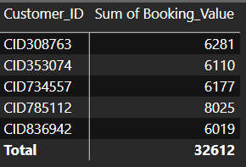
Top 5 Revenue-Generating Customers
This analysis identifies the top 5 customers who contributed the highest booking revenue to the platform.
This helps the company identify high-value customers who contribute significantly to overall revenue.
These customers can be targeted for loyalty programs, premium services, or personalized offers to improve customer retention.

Slide 12
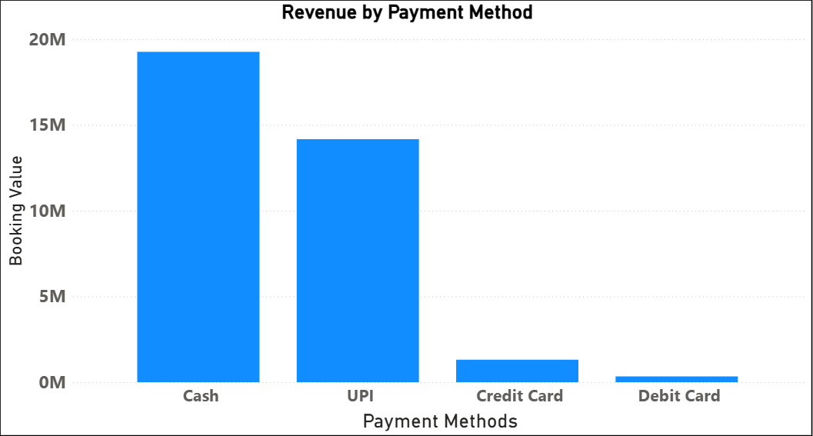
Revenue Distribution by Payment Method
This chart shows the total booking revenue generated through different payment methods.
The analysis shows that Cash is the most frequently used payment method in terms of booking value contribution, while UPI is the second-largest contributor. Digital card-based payments such as Credit Card and Debit Card have relatively lower adoption among customers.

Slide 13
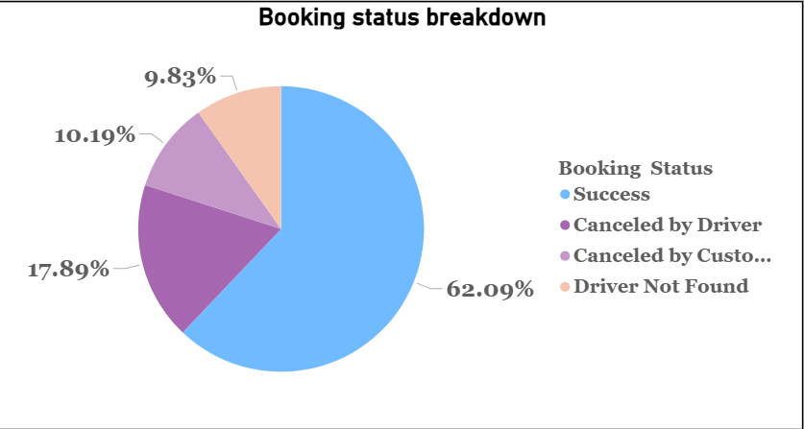
Booking Status Breakdown
This chart shows the distribution of booking outcomes on the platform.
Around 62.09% of bookings were completed successfully, which represents the majority of ride requests.
However, a significant portion of bookings were cancelled by drivers and customers.
Driver-side cancellations account for 17.89%, while customer-side cancellations contribute 10.19%.
Additionally, 9.83% of bookings failed because drivers were not available.
The high cancellation and driver unavailability rates may negatively impact customer satisfaction and operational efficiency.

Slide 14
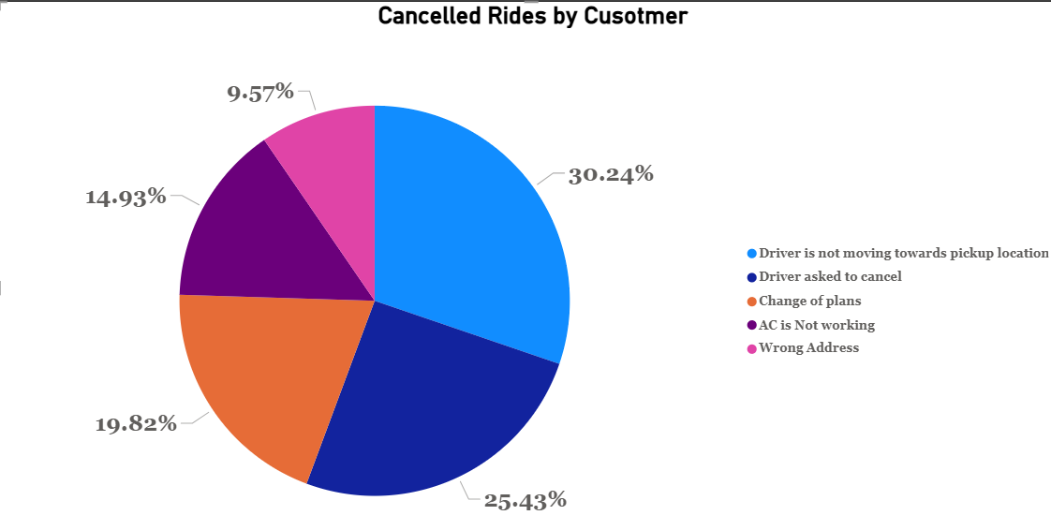
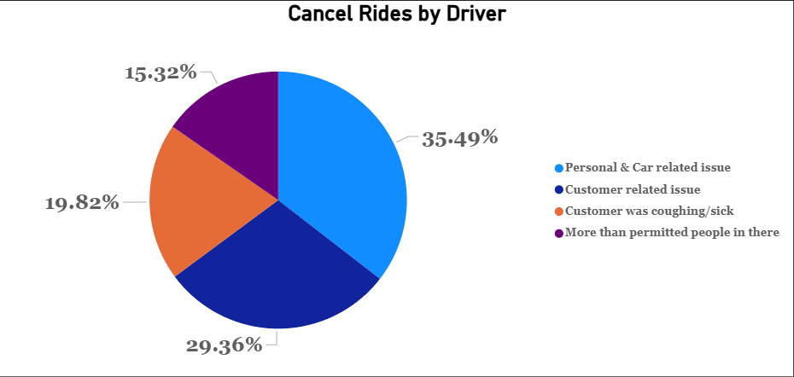
Customer Vs. Driver Cancellation

Slide 15
Reasons for Customer Ride Cancellations
The most common reason was that drivers were not moving toward the pickup location, contributing around 30% of customer cancellations.
Another major reason was drivers asking customers to cancel the ride.
These issues may reduce customer trust and negatively affect user experience.
The platform can reduce cancellations by improving driver accountability and reducing pickup delays.
Reasons for Driver Ride Cancellations
Personal and car-related issues were the leading cause, contributing around 35% of driver cancellations.
“Customer-related issues and customer behavior also contributed significantly
his suggests that both operational issues and rider behavior affect ride completion rates.
Reducing driver-side operational issues could improve overall booking success rates.

Slide 16
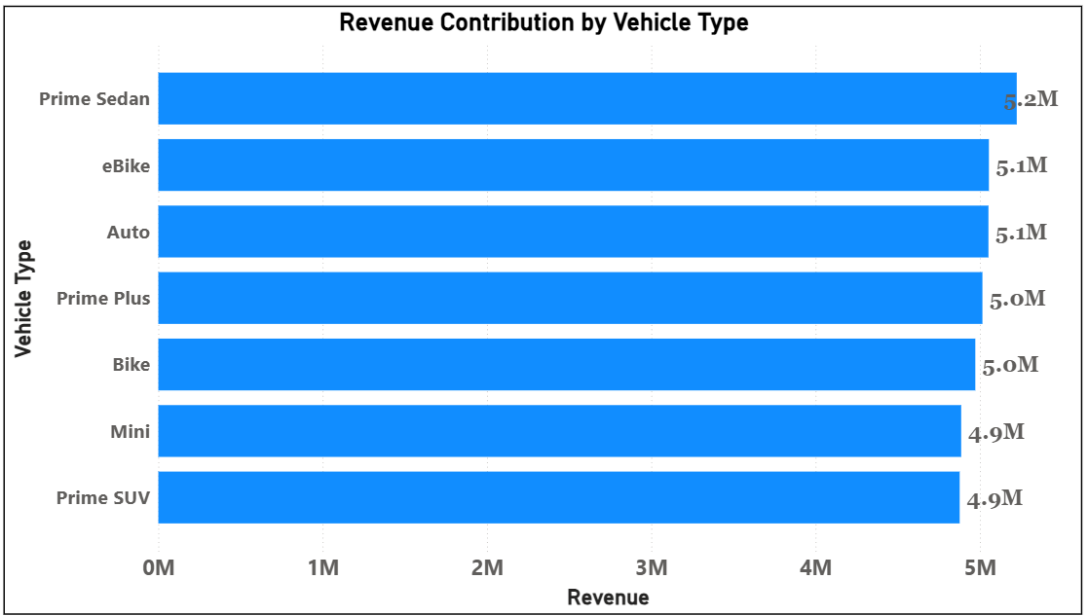
Revenue Contribution by Vehicle Type
This chart shows the total revenue generated by each vehicle category.
Prime Sedan generated the highest revenue contribution, followed closely by eBike and Auto services.
Most vehicle categories contributed nearly similar revenue, indicating balanced customer demand across services.
This suggests that customers use different vehicle categories for different travel needs rather than relying heavily on a single category.
no vehicle type dominates revenue heavily
revenue distribution is relatively balanced

Slide 17
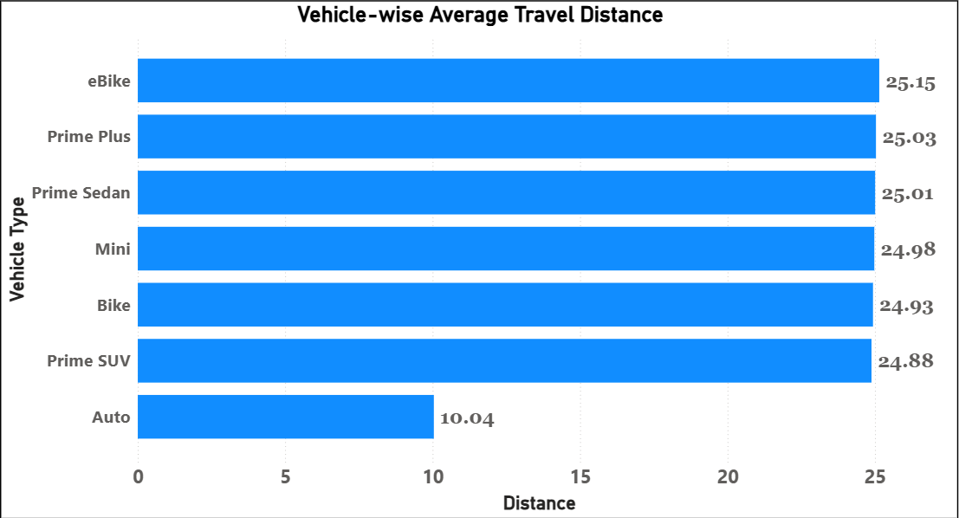
Average Travel Distance
This chart shows the average travel distance per ride across vehicle categories.
Most premium and bike-based vehicle categories recorded an average trip distance of around 25 kilometers.
However, Auto rides showed a significantly lower average distance of approximately 10 kilometers.
This indicates that Auto services are primarily preferred for short-distance urban travel, while premium and bike categories are used for comparatively longer trips.
Overall, the analysis indicates that different vehicle categories serve different customer travel behaviors. Auto services dominate short-distance urban mobility, while premium categories are more associated with longer-distance travel.

Slide 18
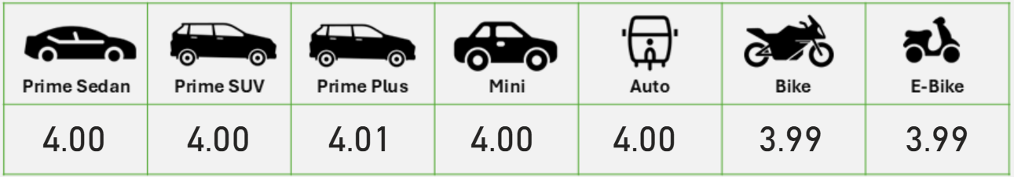
Customer Satisfaction Across Vehicle Types
This analysis compares customer ratings across different vehicle categories to evaluate customer satisfaction and service quality.
The ratings across all vehicle categories are highly consistent, with average ratings close to 4.0
Prime Plus received the highest average customer rating at 4.01, while Bike and E-Bike categories recorded slightly lower ratings at 3.99.
The minimal variation in ratings suggests that the platform is delivering relatively consistent service quality across all vehicle categories.
Overall, the platform maintains a stable customer satisfaction level across different vehicle categories, indicating a fairly consistent user experience.

Slide 19
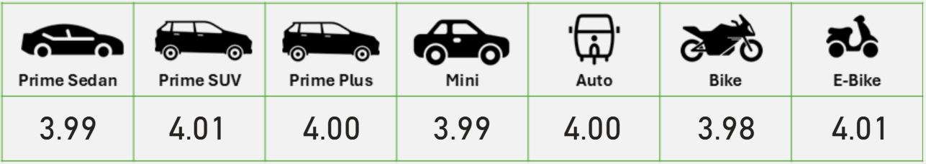
Driver Satisfaction Across Vehicle Types
This analysis compares driver ratings across different vehicle categories to evaluate overall service experience and operational consistency.
The average driver ratings across all vehicle categories are highly consistent, ranging between 3.98 and 4.01.
Prime SUV and E-Bike recorded the highest average ratings of 4.01, while Bike services received the lowest average rating at 3.98.
However, the variation in ratings is very small, indicating that service quality remains relatively stable across all vehicle categories
Overall, the platform maintains a consistent driver experience across vehicle categories, with only minimal variation in customer ratings

Slide 20
Key Findings
The platform recorded a high volume of bookings, indicating strong customer demand and active platform usage.
Most vehicle categories contributed nearly similar revenue, showing balanced customer preference across different ride services.
Around 62% of bookings were successfully completed, while a significant percentage of bookings were cancelled, impacting operational efficiency.
A large portion of customer cancellations occurred due to drivers not moving toward pickup locations or asking customers to cancel rides.
Auto services were mainly used for short-distance travel, while premium vehicle categories were preferred for longer-distance rides.
Cash and UPI emerged as the dominant payment methods, whereas card-based payments showed comparatively lower usage.
. Customer and driver ratings across all vehicle categories remained stable around 4.0, indicating relatively consistent service quality

Slide 21
Business Recommendations
The company should closely monitor ride cancellations and identify drivers who frequently cancel bookings. Proper accountability measures and performance tracking can help reduce unnecessary cancellations. Additionally, providing rewards or incentives to drivers for successfully completing more rides can encourage better service and improve the overall booking success rate.
Optimize nearest-driver matching and pickup management to reduce waiting time and improve ride fulfillment.
The company should provide better support and proper training to drivers so they can handle rides more efficiently and professionally. Regular vehicle maintenance checks should also be conducted to reduce car-related problems during rides. These improvements can help minimize ride cancellations and provide a smoother experience for customers.
Encourage UPI and card payments through cashback offers, discounts, and loyalty rewards to reduce cash dependency.
Reduce ride delays and cancellation frequency to improve customer trust, retention, and repeat bookings.
Continuously track booking trends, cancellation reasons, customer ratings, and payment behavior to support better business decision-making.

Slide 22
Thank You

